Slide 1
Facilitator Training
February 2013
Peter Broffman

Slide 2
Agenda (key items)
Introduction to Intel® Easy Steps
Basic Course
Help Guide
Activity Cards
Tips on how to Facilitate the Course
Walk-thru of course modules
Practice Sessions (and peer feedback)
Organizing for the specific volunteer opportunity in OR

Slide 3
Introductions
Name
Where are you from?
Current job
Have you done computer training before?
One word to describe you
What you want to know (or know how to do) by the end of today

Slide 4
Schedule for Train-the-Trainer
Time | Minutes | Activity
8:00-8:30 | 30 | Welcome and Introductions
8:30-8:35 | 5 | Review of Schedule
8:35-8:45 | 10 | Overview of Intel® Easy Steps
8:45-9:00 | 15 | Introduction to the Basic Course
9:00-9:45 | 45 | Walk-Thru of Modules 1-5
9:45-10:00 | 15 | BREAK
10:00-10:30 | 30 | Introducing the Intel® Education Help Guide
10:30-11:00 | 30 | Tips on Facilitating the Course
11:00-11:45 | 45 | Learner Practice: Module 3: Create a Flyer (Module 3, Activity 3)
11:45-11:55 | 10 | Reflection on Practice Session
11:55-12:00 | 5 | Assignments for Facilitation Practice
12:00-1:00 | 60 | LUNCH (and prepare for Facilitation practice)
1:00-1:45 | 45 | Facilitation Practice: Create a Monthly Budget (Module 4, Activity 3)
1:45-2:00 | 15 | Reflection on Practice Session
2:00-2:45 | 45 | Facilitation Practice: Using Multimedia (Module 5, Activity 3)
2:45-3:00 | 15 | Reflection on Practice Session
3:00-3:15 | 15 | BREAK
3:15-3:30 | 15 | Showcasing the Work (Modules 13-14)
3:30-4:00 | 30 | Activity Cards
4:00-4:30 | 30 | Training Action Planning
4:30-4:45 | 15 | Plus/Minus of training

Slide 5
OVERVIEW

Slide 6
Intel® Easy Steps
What is it?
A basic technology literacy education program.
Who’s it for?
Adult learners with little or no experience with computers.
What does it teach?
Participants learn the “basics” of the computer, enabling them
to use the computer in ways that are relevant to their daily lives.
What skills will participants learn?
Through active, hands-on experience, participants learn to explore
and use basic computer applications that are used in everyday life:
Internet Spreadsheets
Email Multimedia
Word processing Skype
Social Media (FB)
What will this enable participants to do?
Communicate with friends, family and business associates though email, research and access information on the Internet, create resumes, flyers, invitations, budgets, business documents, presentations, and more.
Optional modules: How to apply basic skills to business and entrepreneurship

Slide 7
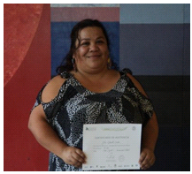
Intel® Easy Steps is used as a key program to address Empowerment of Women

Slide 8
Case Example:
Lubna
39 year-old woman from Pakistan
Works as tailor in her village
Has never travelled outside her province
Completed Intel® Easy Steps
Now uses a computer to:
Research clothing designs from around the world
Create designs
Market her business
“I attended the Intel Easy Steps workshop and learnt about computers for the first time. I was so motivated as a new user …the experience completely changed my life”

Slide 9
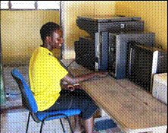
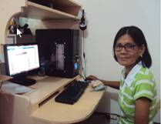
Anastasia
20 year old from a remote part of Kenya
Orphaned very young
Left school at 12 with no means to pursue a career.
Enrolled in the Intel® Easy Steps program in 2011
Recently hired as an office assistant at local community development centre
Now: Supports herself and her grandmother.
Eufemia
50 year old Filipina woman
Eufemia and her husband are farmers
Attended the Intel Easy Steps training, she was introduced to Internet and social media.
Searched for her son, whom she had not seen or communicated with in seven years.
Found her son using Facebook, and has since had a Skype call with him
Exploring how the computer can help her in her farming.

Slide 10
Intel® Easy Steps Program Offerings
Intel® Easy Steps
Program Components
Intel Easy Steps
Basic Course
(facilitated course)
Intel Easy Steps
Activity Cards
(self-instruction)
Intel Education
Help Guide*
(self-instruction)
plus
plus
Modules 1-5
Introduction to computer operations and basic applications
Practical examples for adult users
Modules 6-12 (optional)
How to apply basic skills in employment and entrepreneurship
Additional tools (Skype, Google Docs, Social Media)
Modules 13-14
Build a Portfolio
Showcase Your Work
Step-by-Step instruction on how to create a specific document or artifact
May be customized for specific targeted audiences.
May be used to supplement Basic Course, or for independent self-instruction
Supports: Basic Course and Activity Cards
Provides step-by-step instructions for hundreds of SW productivity tasks in user-friendly, non-technical language.
Visual images accompany each step to show how it's done.
* See: http://www.intel.com/education/helpguide

Slide 11
Let’s start with…
Intel® Easy Steps
Basic Course

Slide 12
Intel® Easy Steps Basic Course Content
Module | Title | Activity
PART 1 - Learning New Skills
1 | Introducing Computers and Operating Systems | Basic PC operations, create files, keyboarding, Notepad
2 | Introducing Internet and Email | Internet search, browsing, create and use email
3 | Introducing Word Processing | Explore WP; create flyer, resume, greeting Card
4 | Introducing Spreadsheets | Explore Spreadsheet; create budget, address book
5 | Introducing Multimedia | Explore PPT; create presentation, add graphics, media
PART 2 - Applying Skills to Business and Entrepreneurship
6 | Introduction to Entrepreneurship | Create Mind Map (business ideas) via PPT and Graphics
7 | Money Management & Finances | Start-up Costs and Cash Flow, sharing thru Skype
8 | Developing a Marketing Plan | Create Mkt. Plan presentation, communicate via email
9 | Branding | Create logo, letterhead, business cards, email signature
10 | Marketing Material | Create brochure, catalogue; communicate via Skype
11 | Online Marketing | Create web site, use social media (FB) to communicate
12 | Collecting Feedback Online | Create survey (Google Docs), share via Skype Share
PART 3 - Showcasing Your Work
13 | Developing a Product Portfolio | Prepare presentation using PPT
14 | Showcase | Present your PTT presentation showing your work
Supported by Intel® Education Help Guide
http://www.intel.com/education/helpguide/index.htm

Slide 13
Course Approach: Learners complete documents and do activities that they can find immediately useful
Session begins with a
technology introduction and
“hands on” exploration
Exploration
Guided Practice
Activity Application
Sharing
Skills Checklist
Learners
complete
a skills set
checklist
Learners engage
in a
Guided
Practice
using the
technology
Module
Structure
Learners share their
work and discuss how this
application can be
used in other ways
Learners complete
at least one relevant
document or activity using
the technology

Slide 14
“Learner-Centered” Approach
Activities are relevant to the participant’s daily lives
Learners learn by doing (active learning)
“Hands-On” approach
Hands on mouse and keys as early as possible
Learners learn from exploring, doing
Course is structured, but minimum of facilitator “instruction”
Facilitator should often say: “Try it, see what happens”
Learners learn from each other
Hierarchy for solving problems:
Fellow learners
Help Guide
Facilitator

Slide 15
Role of the Facilitator
Create a supportive learning environment
Make sure participants understand that it’s OK to make mistakes (everyone does when learning something new)
Assure them: They won’t “break” anything
Guide the process and discussions
Follow the structure of the course materials
Engage all participants in discussions
Encourage participants
Provide and promote constructive feedback
Clarify concepts and answer questions
Provide demonstrations when helpful (some people are visual learners)

Slide 16
Let’s Review…
Modules 1-5

Slide 17
Module 1: Introducing Computers and Operating Systems
Activity
Welcome and Introduction to Course
Activity 1: Introducing Yourself
Activity 2: Do You Know Computers?
Activity 3: Parts of the Computer
Activity 4: Introduction to Operating System
Activity 5: Using the Mouse
Activity 6: Using Notepad
Activity 7: Basic Computer Operations
Activity 8: Using What I Learned
Open the course manual and take a look…

Slide 18
Module 2: Introducing Internet and Email
Activity
Introduction to Internet and Email
Activity 1: Exploring the Help Guide
Activity 2: Learning Internet Basics
Activity 3: Exploring Web Browser
Activity 4: Exploring Search Engines
Activity 5: Introducing Email
Activity 6: Using What I Learned
Open the course manual and take a look…

Slide 19
Module 3: Introducing Word Processing
Activity
Introduction to Word Processing
Activity 1: Exploring Word Processing
Activity 2: Getting to Know Word Processing using the Help Guide
Activity 3: Using Word Processing Skills
Activity 4: Using What I Learned
Open the course manual and take a look…

Slide 20
Module 4: Introducing Spreadsheets
Activity
Introduction to Spreadsheets
Activity 1: Exploring Spreadsheets
Activity 2: Getting to Know Spreadsheets using the Help Guide
Activity 3: Using Spreadsheet Skills
Activity 4: Using What I Learned
Open the course manual and take a look…

Slide 21
Module 5: Introducing Multimedia
Activity
Introduction to Multimedia
Activity 1: Exploring Multimedia
Activity 2: Getting to Know Multimedia using the Help Guide
Activity 3: Using Multimedia Skills
Activity 4: Using What I Learned
Open the course manual and take a look…

Slide 22
Introducing the…
Intel® Education Help Guide
http://www.intel.com/education/helpguide/index.htm

Slide 23
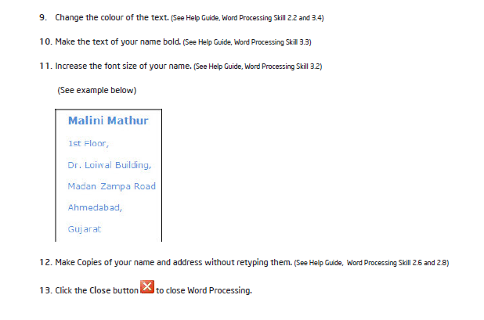
A reference to the Help Guide is imbedded in most every step

Slide 24
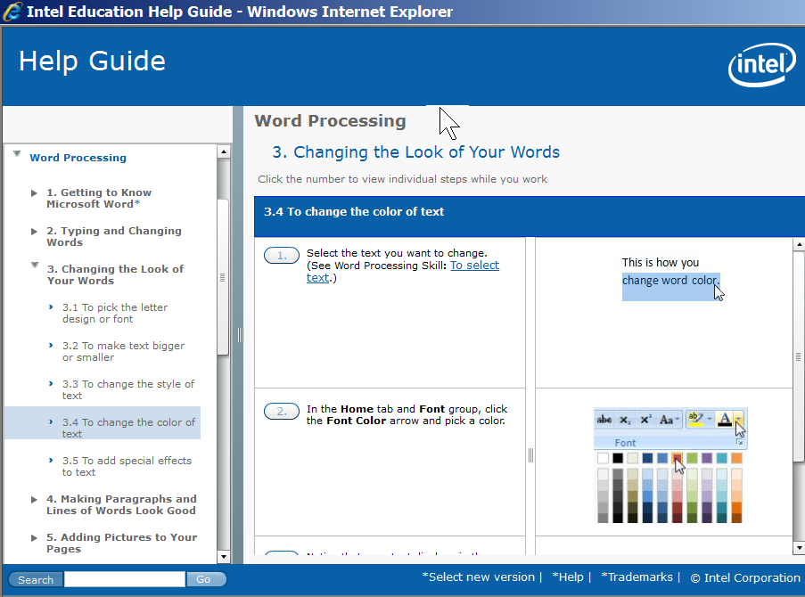
Example of Help Guide page

Slide 25
How to Use the Help Guide

Slide 26
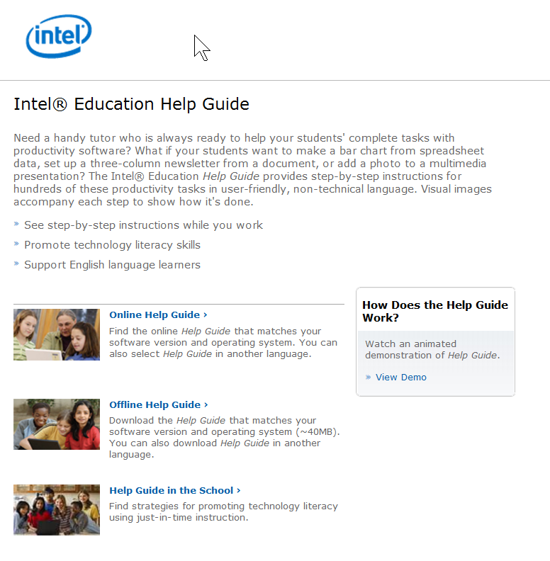
You can access the Intel Education Help Guide from the Intel web site. Using your web browser, type in: http://www.intel.com/education/helpguide
That will take you to a landing page that looks like this.
Note that there is a brief video that will demonstrate how to use the Help Guide
You can start the Help Guide by putting your cursor over the words Online Help Guide, then “left click”

Slide 27
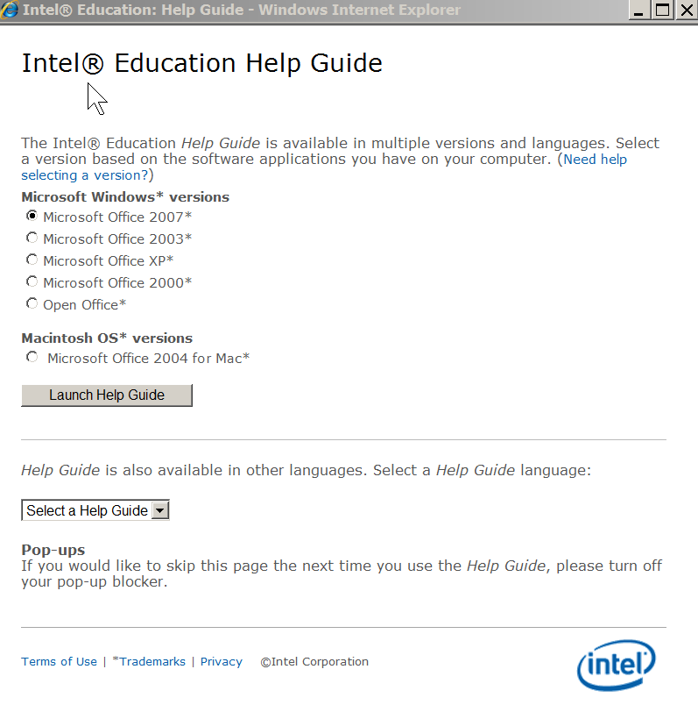
You will then see a screen that will prompt you to either launch the Help Guide,
Or,
Select an option available in another language

Slide 28
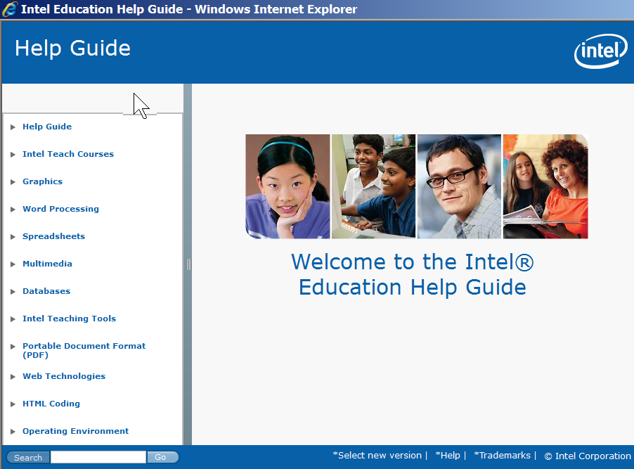
When the Help Guide opens, you’ll see a Welcome page that looks like this. Note that in the left channel, there are links to a variety of types of software instruction.
For this example, suppose you are looking for the Help Guide section on Graphics, Skill 9.1. Start by putting your cursor over the word Graphics, then “left click”

Slide 29
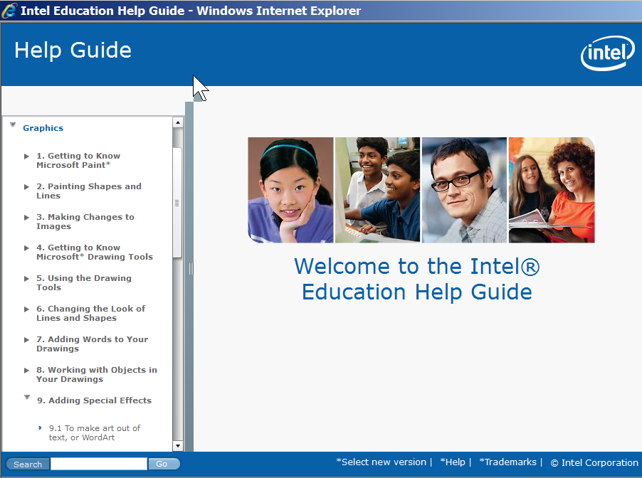
When you open the section on Graphics, scroll down until you find the skill you were looking for: Skill 9.1: To make art out of text or Word Art . Put your cursor over that section, and “left click”

Slide 30
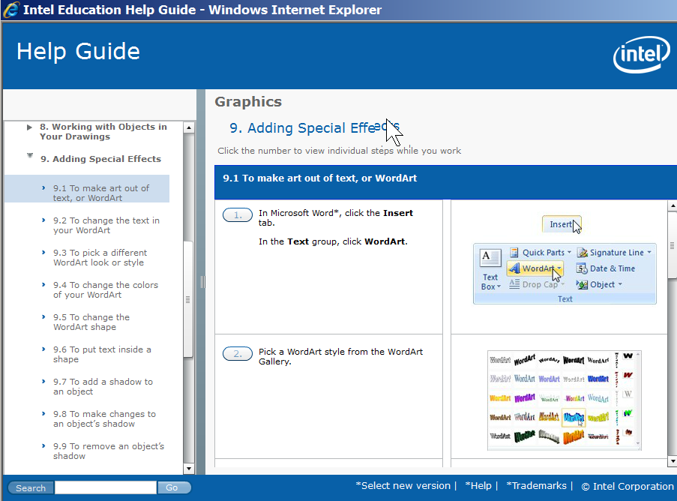
That will open the screen that gives you the step-by-step instructions you need to make art out of text or Word Art
You can view the steps in two ways. One way is to scroll through to see all the steps. Use the scroll bar on the right

Slide 31
The other way is to put your cursor on top of the number 1 on the first step, and “left click”.

Slide 32
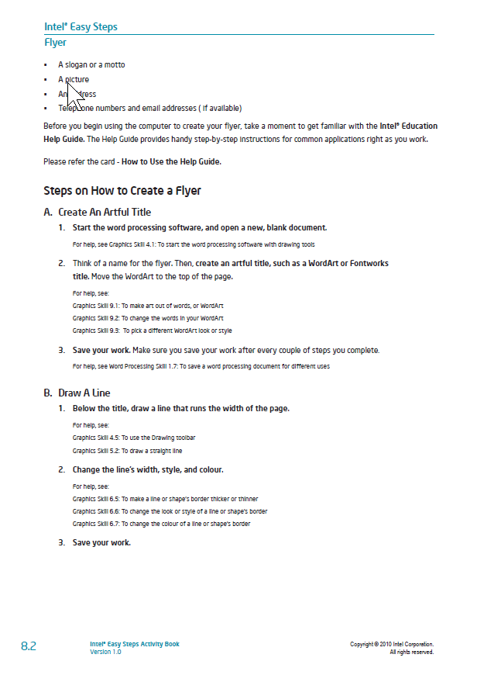
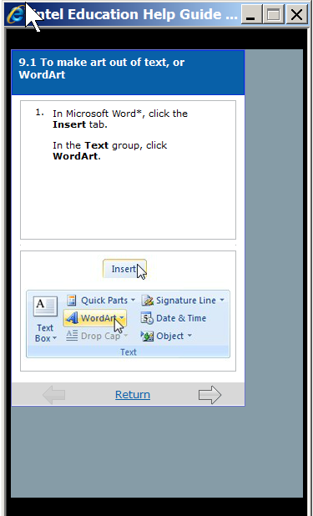
That will put the Help Guide step into a smaller window, which you can see on your screen at the same time as you work on your project. To advance to the next skill step, simply click on the arrow at the bottom of the window.

Slide 33
Help Guide challenge
How can I?
View a document as it looks on the Internet
Reuse a formula in many cells in the same row or column of a spreadsheet
What sections of the Help Guide will help
you do each of those tasks?

Slide 34
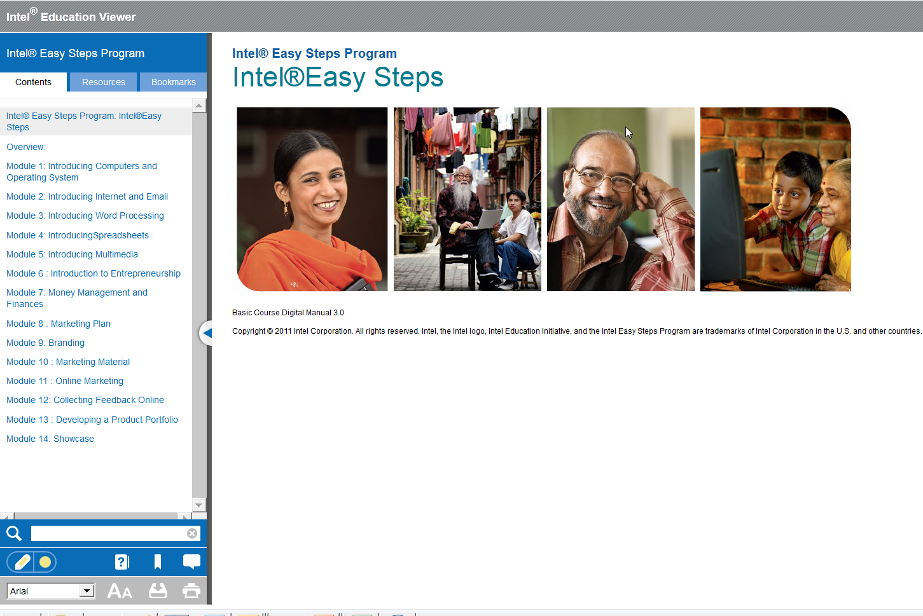
Digital Viewer (available in some languages)
Merges and links: Basic Course manual with Intel® Education Help Guide
www.intelviewer.org

Slide 35
Tips on… How to Facilitate the Course

Slide 36
Tips for facilitating the training
Have participants work in pairs/teams (two per computer)
If literacy level of participants is high enough, have participants read some of the module introductions and instructions
When introducing each module, focus on the product they’ll produce, not the software task
e.g. “Today you’re going to learn to produce a resume or a flyer”, not “Today you’re going to learn to format text”
Engage participants in discussions indicated in the manual
Provide a demonstration when helpful
Use projector to show steps if participants having difficulty

Slide 37
Issues you may confront…
Fear of making mistakes
Low literacy levels
Little or no keyboarding skills
Different levels of experience/ability among participants
What are some ways to address those issues?

Slide 38
Let’s try a session…
Module 3: Create a Flyer
(Module 3, Activity 3)
For this session, you will participate as a Learner

Slide 39
Reflection…
What worked?
What didn’t?
How could it be better?

Slide 40
Let’s try another session…
Module 4: Create a Monthly Budget
(Module 4, Activity 3)
Two participants/trainers will have a chance to
deliver this session to others

Slide 41
Reflection…
What worked?
What didn’t?
How could it be better?

Slide 42
Let’s try another session…
Module 5: Using Multimedia
(Module 5, Activity 3)
Two participants/trainers will have a chance to
deliver this session to others

Slide 43
Reflection…
What worked?
What didn’t?
How could it be better?

Slide 44
The “Showcase” Modules 13-14
Do a Showcase even if you only covered Modules 1-5
Value:
Provides opportunity for participants to show what they’ve learned
Builds confidence, self-esteem (“success breeds success”)
Open the course manual and take a look…

Slide 45
Let’s explore…
Intel® Easy Steps
Activity Cards

Slide 46
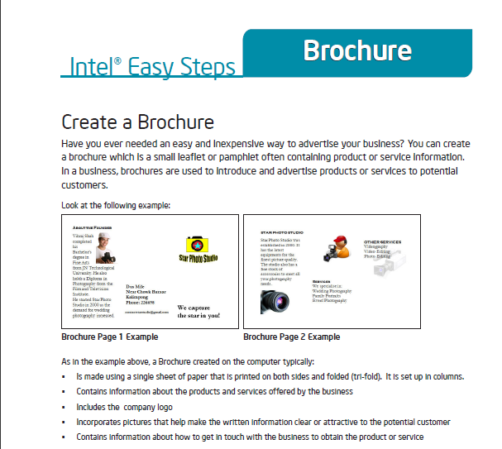
Intel® Easy Steps Activity Cards
Self-Instruction in key technology areas
Intel Easy Steps provides a series of Activity Cards, each of which provides instruction on how to create a useful product or complete a specific task.
Each Activity Card has:
A sample of the product
Step-by-Step instructions to create the product, supported by the Intel® Education Help Guide
A “Challenge” suggesting a way to improve the product
Review Checklist
Partial SAMPLE
Examples of Products:
Advertisement/Poster
Brochure
Budget
Flyer
Invitation
Letter
Newsletter
Activity Cards: http://www.intel.com/education/easysteps_activitycards/

Slide 47
Develop a Training Plan

Slide 48
Plan the training schedule
Each module: approximately 2 hours long
Schedule time between sessions for learners to practice
Ideal is to conduct 2-3 sessions per week, with at least one day in between for practice
Do at least first five modules (others are optional)

Slide 49
Your Responsibilities BEFORE the training
Make sure PCs have installed:
Basic Course
Help Guide
Office Applications (MS Office or equivalent)
Print:
Required: Modules 1-5
Optional: Modules 6-14
Internet:
Check on connectivity
Consider whether to skip or defer Module 2 (may be done last)
Read and Prepare
Read through Modules 1-5
Be sure you understand all the activities ahead of time
Explore using the Help Guide
If you’re using the Digital Viewer, explore using it before the training
Prepare any presentation slides you would like to use
Alternative: Digital Viewer that incorporates Basic Course manual and Help Guide
If possible, arrange for a projector and screen

Slide 50
Your Responsibilities BEFORE the training
TODAY: Sign-up for modules
Each person will lead a module as facilitator
Plan to be a coach the week before you lead
Sign up for any 3rd week to coach
For the Module you will lead as facilitator
More preparation time
Be sure you understand all the activities ahead of time
If possible bring in a finished product
Prepare any presentation slides you would like to use

Slide 51
Training Schedule
 | Module 1 Intro to Computers | Module 2 Internet and Email | Module 3 Word Processing | Module 4 Intro to Spreadsheets | Module 5 Multimedia/ Presentations | Showcase!
 | 3/06/13 | 3/13/13 | 3/20/13 | 4/03/13 | 4/10/13 | 4/17/13
Lead Facilitators | Karim | David | Jeannette | Karim | Raul K | Raul K
 | Jeannette | Raul A | Rosana | Rosana | Sandra
Coaches | David | Jeannette | David | Craig | Craig | Sandra
 | Raul A | Rose | Raul A | Eduardo | Rose | Rose
 | Rose | Rosana | Craig | Raul K | Lilian | Lilian
 | Lilian |  |  | Rose
 | Raul K
 | Jose | Jose | Jose | Jose | Jose | Jose
NOTE: No class on Wednesday, 3/27 for Spring Break

Slide 52
My Action Steps
These are the steps I (we) will take before delivering the Intel Easy Steps training
Activity | Person | Due date

Slide 53
What did you think of this training?
PLUS (Positive things about this training) | MINUS (Could use improvement)

Slide 54
Back-Up (Slides trainers can use with Participants)

Slide 55
Welcome!

Slide 56
Welcome to Intel® Easy Steps
What does this course teach you?
The “basics” of the computer
How to use the computer in ways that are relevant to your daily lives.
What skills will you learn?
How to use basic computer applications that are used in everyday life:
Internet Spreadsheets
Email Multimedia
Word processing Skype
Social Media (FB)
What will this enable participants to do?
Communicate with friends, family and business associates though email
Research and access information on the Internet
Create resumes, flyers, invitations, budgets, business documents, presentations, and more.
Use and apply basic skills to business and entrepreneurship

Slide 57
Training Schedule for Basic Course Participants (Modules 1-5)

Slide 58
Module 1: Introducing Computers and Operating Systems
Minutes* | Activity
10 | Welcome and Introduction to Course
10 | Activity 1: Introducing Yourself
5 | Activity 2: Do You Know Computers?
10 | Activity 3: Parts of the Computer
10 | Activity 4: Introduction to Operating System
15 | Activity 5: Using the Mouse
30 | Activity 6: Using Notepad
20 | Activity 7: Basic Computer Operations
10 | Activity 8: Using What I Learned
* Estimate only. Please be flexible, and allow for more time if needed by participants to complete each activity.

Slide 59
Module 2: Introducing Internet and Email
Minutes* | Activity
5 | Introduction to Internet and Email
15 | Activity 1: Exploring the Help Guide
10 | Activity 2: Learning Internet Basics
20 | Activity 3: Exploring Web Browser
30 | Activity 4: Exploring Search Engines
30 | Activity 5: Introducing Email
10 | Activity 6: Using What I Learned
* Estimate only. Please be flexible, and allow for more time if needed by participants to complete each activity.

Slide 60
Module 3: Introducing Word Processing
Minutes* | Activity
5 | Introduction to Word Processing
15 | Activity 1: Exploring Word Processing
30 | Activity 2: Getting to Know Word Processing using the Help Guide
60 | Activity 3: Using Word Processing Skills
10 | Activity 4: Using What I Learned
* Estimate only. Please be flexible, and allow for more time if needed by participants to complete each activity.

Slide 61
Module 4: Introducing Spreadsheets
Minutes* | Activity
5 | Introduction to Spreadsheets
15 | Activity 1: Exploring Spreadsheets
30 | Activity 2: Getting to Know Spreadsheets using the Help Guide
60 | Activity 3: Using Spreadsheet Skills
10 | Activity 4: Using What I Learned
* Estimate only. Please be flexible, and allow for more time if needed by participants to complete each activity.

Slide 62
Module 5: Introducing Multimedia
Minutes* | Activity
5 | Introduction to Multimedia
15 | Activity 1: Exploring Multimedia
30 | Activity 2: Getting to Know Multimedia using the Help Guide
60 | Activity 3: Using Multimedia Skills
10 | Activity 4: Using What I Learned
* Estimate only. Please be flexible, and allow for more time if needed by participants to complete each activity.

Slide 63
Module 6: Introducing Entrepreneurship
Minutes* | Activity
5 | Introduction to Entrepreneurship
55 | Activity 1: Explore a Business Idea: Create a Mind Map
30 | Activity 2: Share your Business Idea using Skype
20 | Activity 3: Share Mind Map with a Mailing Group
10 | Activity 4: Using What I Learned
* Estimate only. Please be flexible, and allow for more time if needed by participants to complete each activity.

Slide 64
Module 7: Money Management and Finances
Minutes* | Activity
5 | Introduction to Money Management
45 | Activity 1: Estimating Start-up Costs
40 | Activity 2: Estimating Cash Flow
20 | Activity 3: Sharing and sending files on a Skype call
10 | Activity 4: Using What I Learned
* Estimate only. Please be flexible, and allow for more time if needed by participants to complete each activity.

Slide 65
Module 8: Marketing Plan
Minutes* | Activity
5 | Introduction to a Marketing Plan
80 | Activity 1: Developing a Marketing Plan
25 | Activity 2: Discussing your Plan: Sending an Event Invitation
10 | Activity 3: Using What I Learned
* Estimate only. Please be flexible, and allow for more time if needed by participants to complete each activity.

Slide 66
Module 9: Branding
Minutes* | Activity
5 | Introduction to Branding
50 | Activity 1: Developing a Logo
45 | Activity 2: Developing Business Cards
10 | Activity 3: Creating an Email Signature
10 | Activity 4: Using What I Learned
* Estimate only. Please be flexible, and allow for more time if needed by participants to complete each activity.

Slide 67
Module 10: Marketing Material
Minutes* | Activity
5 | Introduction to Marketing Material
75 | Activity 1: Designing a Brochure
30 | Activity 2: Share and discuss on a Skype video call
10 | Activity 3: Using What I Learned
* Estimate only. Please be flexible, and allow for more time if needed by participants to complete each activity.

Slide 68
Module 11: Online Marketing
Minutes* | Activity
5 | Introduction to Online Marketing
60 | Activity 1: Designing a Web Site
40 | Activity 2: Using Social Media
10 | Activity 3: Using What I Learned
* Estimate only. Please be flexible, and allow for more time if needed by participants to complete each activity.

Slide 69
Module 12: Collecting Feedback Online
Minutes* | Activity
5 | Introduction to Online Feedback
60 | Activity 1: Designing online Feedback Forms
40 | Activity 2: Share on a Skype call using Share Screen
10 | Activity 3: Using What I Learned
* Estimate only. Please be flexible, and allow for more time if needed by participants to complete each activity.

Slide 70
Module 13: Developing a Product Portfolio
Minutes* | Activity
5 | Introduction to Portfolios
70 | Activity 1: Developing a Product Portfolio
30 | Activity 2: Making Effective Presentations
10 | Activity 3: Using What I Learned
* Estimate only. Please be flexible, and allow for more time if needed by participants to complete each activity.

Slide 71
Module 14: Showcase
Minutes* | Activity
5 | Introduction to Showcase
60 | Activity 1: Delivering your Portfolio Showcase
40 | Activity 2: Reflection on the Showcase
10 | Activity 3: Using What I Learned
* Estimate only. Please be flexible, and allow for more time if needed by participants to complete each activity.

Slide 72
Contact
Peter Broffman
Corporate Affairs Group
Email: peter.broffman@intel.com
Phone: +1-503-613-3193

