Slide 1
Program Overview
September 2012

Slide 2
Intel® Easy Steps
What is it?
A basic technology literacy education program.
Who’s it for?
Adult learners with little or no experience with computers.
What does it teach?
Participants learn the “basics” of the computer, enabling them
to use the computer in ways that are relevant to their daily lives.
What skills will participants learn?
Through active, hands-on experience, participants learn to explore
and use basic computer applications that are used in everyday life:
Internet Spreadsheets
Email Multimedia
Word processing Skype
Social Media (FB)
What will this enable participants to do?
Communicate with friends, family and business associates though email, research and access information on the Internet, create resumes, flyers, invitations, budgets, business documents, presentations, and more.
Optional modules: How to apply basic skills to business and entrepreneurship

Slide 3
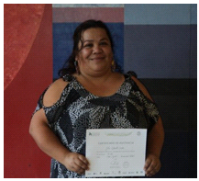
Intel® Easy Steps is used as a key program to address Empowerment of Women

Slide 4
Case Example:
Lubna
39 year-old woman from Pakistan
Works as tailor in her village
Has never travelled outside her province
Completed Intel® Easy Steps
Now uses a computer to:
Research clothing designs from around the world
Create designs
Market her business
“I attended the Intel Easy Steps workshop and learnt about computers for the first time. I was so motivated as a new user …the experience completely changed my life”

Slide 5
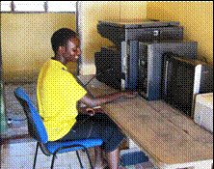
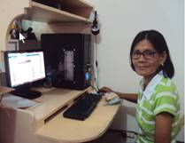
Anastasia
20 year old from a remote part of Kenya
Orphaned very young
Left school at 12 with no means to pursue a career.
Enrolled in the Intel® Easy Steps program in 2011
Recently hired as an office assistant at local community development centre
Now: Supports herself and her grandmother.
Eufemia
50 year old Filipina woman
Eufemia and her husband are farmers
Attended the Intel Easy Steps training, she was introduced to Internet and social media.
Searched for her son, whom she had not seen or communicated with in seven years.
Found her son using Facebook, and has since had a Skype call with him
Exploring how the computer can help her in her farming.

Slide 6
Intel® Easy Steps Program Offerings
Intel® Easy Steps
Program Components
Intel Easy Steps
Basic Course
(facilitated course)
Intel Easy Steps
Activity Cards
(self-instruction)
Intel Education
Help Guide*
(self-instruction)
plus
plus
Modules 1-5
Introduction to computer operations and basic applications
Practical examples for adult users
Modules 6-12 (optional)
How to apply basic skills in employment and entrepreneurship
Additional tools (Skype, Google Docs, Social Media)
Modules 13-14
Build a Portfolio
Showcase Your Work
Step-by-Step instruction on how to create a specific document or artifact
May be customized for specific targeted audiences.
May be used to supplement Basic Course, or for independent self-instruction
Supports: Basic Course and Activity Cards
Provides step-by-step instructions for hundreds of SW productivity tasks in user-friendly, non-technical language.
Visual images accompany each step to show how it's done.
* See: http://www.intel.com/education/helpguide

Slide 7
Intel® Easy Steps
Basic Course

Slide 8
Intel® Easy Steps Basic Course Content
Module | Title | Activity
PART 1 - Learning New Skills
1 | Introducing Computers and Operating Systems | Basic PC operations, create files, keyboarding, Notepad
2 | Introducing Internet and Email | Internet search, browsing, create and use email
3 | Introducing Word Processing | Explore WP; create flyer, resume, greeting Card
4 | Introducing Spreadsheets | Explore Spreadsheet; create budget, address book
5 | Introducing Multimedia | Explore PPT; create presentation, add graphics, media
PART 2 - Applying Skills to Business and Entrepreneurship
6 | Introduction to Entrepreneurship | Create Mind Map (business ideas) via PPT and Graphics
7 | Money Management & Finances | Start-up Costs and Cash Flow, sharing thru Skype
8 | Developing a Marketing Plan | Create Mkt. Plan presentation, communicate via email
9 | Branding | Create logo, letterhead, business cards, email signature
10 | Marketing Material | Create brochure, catalogue; communicate via Skype
11 | Online Marketing | Create web site, use social media (FB) to communicate
12 | Collecting Feedback Online | Create survey (Google Docs), share via Skype Share
PART 3 - Showcasing Your Work
13 | Developing a Product Portfolio | Prepare presentation using PPT
14 | Showcase | Present your PTT presentation showing your work
Supported by Intel® Education Help Guide
http://www.intel.com/education/helpguide/index.htm

Slide 9
Course Approach: Learners complete documents and do activities that they can find immediately useful
Session begins with a
technology introduction and
“hands on” exploration
Exploration
Guided Practice
Activity Application
Sharing
Skills Checklist
Learners
complete
a skills set
checklist
Learners engage
in a
Guided
Practice
using the
technology
Module
Structure
Learners share their
work and discuss how this
application can be
used in other ways
Learners complete
at least one relevant
document or activity using
the technology

Slide 10
“Learner-Centered” Approach
Activities are relevant to the participant’s daily lives
Learners learn by doing (active learning)
“Hands-On” approach
Hands on mouse and keys as early as possible
Learners learn from exploring, doing
Course is structured, but minimum of facilitator “instruction”
Facilitator should often say: “Try it, see what happens”
Learners learn from each other
Hierarchy for solving problems:
Fellow learners
Help Guide
Facilitator

Slide 11
Intel® Easy Steps
Activity Cards

Slide 12
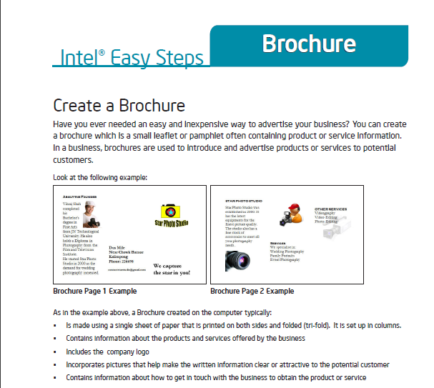
Intel® Easy Steps Activity Cards
Self-Instruction in key technology areas
Intel Easy Steps provides a series of Activity Cards, each of which provides instruction on how to create a useful product or complete a specific task.
Each Activity Card has:
A sample of the product
Step-by-Step instructions to create the product, supported by the Intel® Education Help Guide
A “Challenge” suggesting a way to improve the product
Review Checklist
Partial SAMPLE
Examples of Products:
Advertisement/Poster
Brochure
Budget
Flyer
Invitation
Letter
Newsletter
Activity Cards: http://www.intel.com/education/easysteps_activitycards/

Slide 13
Basic Course and Activity Cards supported by…
Intel® Education Help Guide
http://www.intel.com/education/helpguide/index.htm

Slide 14
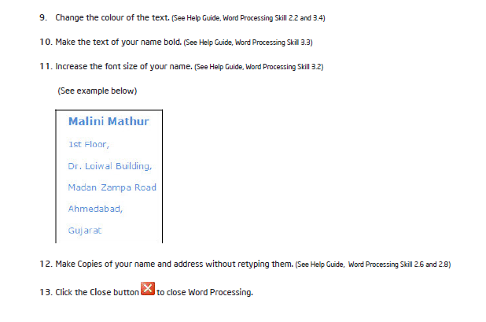
A reference to the Help Guide is imbedded in most every step

Slide 15
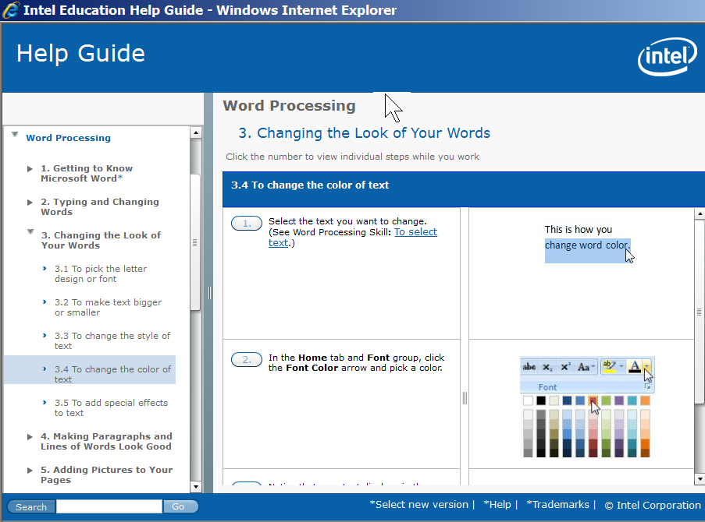
Example of Help Guide page
For more complete explanation of how to use Help Guide, see back-up slides 31-38

Slide 16
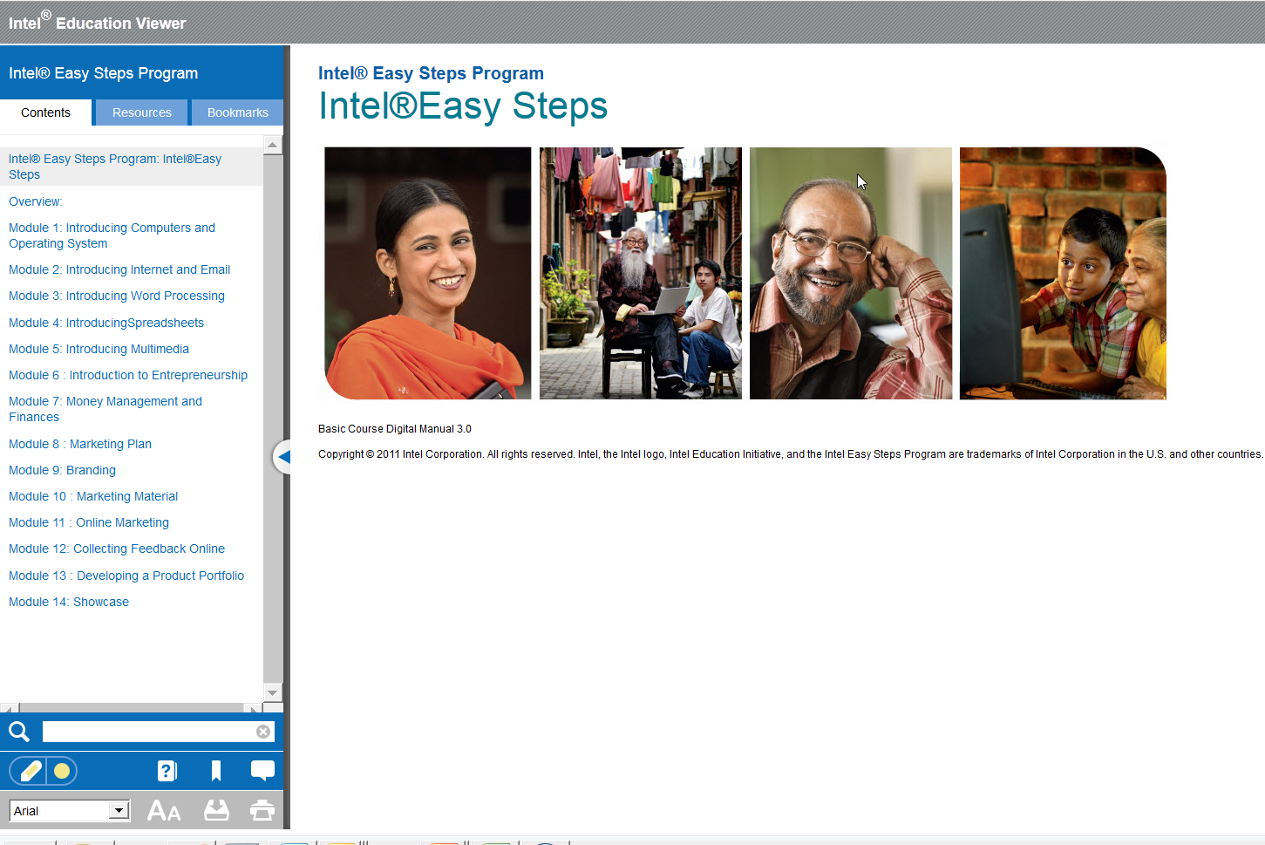
Digital Viewer (available in some languages)
Merges and links: Basic Course manual with Intel® Education Help Guide
www.intelviewer.org

Slide 17
Back-Up

Slide 18
Module 1: Introducing Computers and Operating Systems
Activity
Welcome and Introduction to Course
Activity 1: Introducing Yourself
Activity 2: Do You Know Computers?
Activity 3: Parts of the Computer
Activity 4: Introduction to Operating System
Activity 5: Using the Mouse
Activity 6: Using Notepad
Activity 7: Basic Computer Operations (keyboarding, create files, etc)
Activity 8: Using What I Learned

Slide 19
Module 2: Introducing Internet and Email
Activity
Introduction to Internet and Email
Activity 1: Exploring the Help Guide
Activity 2: Learning Internet Basics
Activity 3: Exploring Web Browser
Activity 4: Exploring Search Engines
Activity 5: Introducing Email (create and send email)
Activity 6: Using What I Learned

Slide 20
Module 3: Introducing Word Processing
Activity
Introduction to Word Processing
Activity 1: Exploring Word Processing
Activity 2: Getting to Know Word Processing using the Help Guide
Activity 3: Using Word Processing Skills (flyer, resume, greeting card)
Activity 4: Using What I Learned

Slide 21
Module 4: Introducing Spreadsheets
Activity
Introduction to Spreadsheets
Activity 1: Exploring Spreadsheets
Activity 2: Getting to Know Spreadsheets using the Help Guide
Activity 3: Using Spreadsheet Skills (budget, address book)
Activity 4: Using What I Learned

Slide 22
Module 5: Introducing Multimedia
Activity
Introduction to Multimedia
Activity 1: Exploring Multimedia
Activity 2: Getting to Know Multimedia using the Help Guide
Activity 3: Using Multimedia Skills (presentation, media)
Activity 4: Using What I Learned

Slide 23
Module 6: Introducing Entrepreneurship
Activity
Introduction to Entrepreneurship
Activity 1: Explore a Business Idea: Create a Mind Map
Activity 2: Share your Business Idea using Skype
Activity 3: Share Mind Map with a Mailing Group
Activity 4: Using What I Learned

Slide 24
Module 7: Money Management and Finances
Activity
Introduction to Money Management
Activity 1: Estimating Start-up Costs
Activity 2: Estimating Cash Flow
Activity 3: Sharing and sending files on a Skype call
Activity 4: Using What I Learned

Slide 25
Module 8: Marketing Plan
Activity
Introduction to a Marketing Plan
Activity 1: Developing a Marketing Plan
Activity 2: Discussing your Plan: Sending an Event Invitation via email
Activity 3: Using What I Learned

Slide 26
Module 9: Branding
Activity
Introduction to Branding
Activity 1: Developing a Logo
Activity 2: Developing Business Cards
Activity 3: Creating an Email Signature
Activity 4: Using What I Learned

Slide 27
Module 10: Marketing Material
Activity
Introduction to Marketing Material
Activity 1: Designing a Brochure
Activity 2: Share and discuss on a Skype video call
Activity 3: Using What I Learned

Slide 28
Module 11: Online Marketing
Activity
Introduction to Online Marketing
Activity 1: Designing a Web Site
Activity 2: Using Social Media
Activity 3: Using What I Learned

Slide 29
Module 12: Collecting Feedback Online
Activity
Introduction to Online Feedback
Activity 1: Designing online Feedback Forms
Activity 2: Share on a Skype call using Share Screen
Activity 3: Using What I Learned

Slide 30
The “Showcase” Modules 13-14
Module 13: Develop a Product Portfolio
Activity 1: Understanding Product Portfolios
Activity 2: Making Effective Presentations
Activity 3: Using What I Learned
Module 14: Showcase
Activity 1: Product Portfolio Showcase
Activity 2: Reflection on the Showcase
Activity 3: Using What I Learned

Slide 31
How to Use the Intel® Education Help Guide

Slide 32
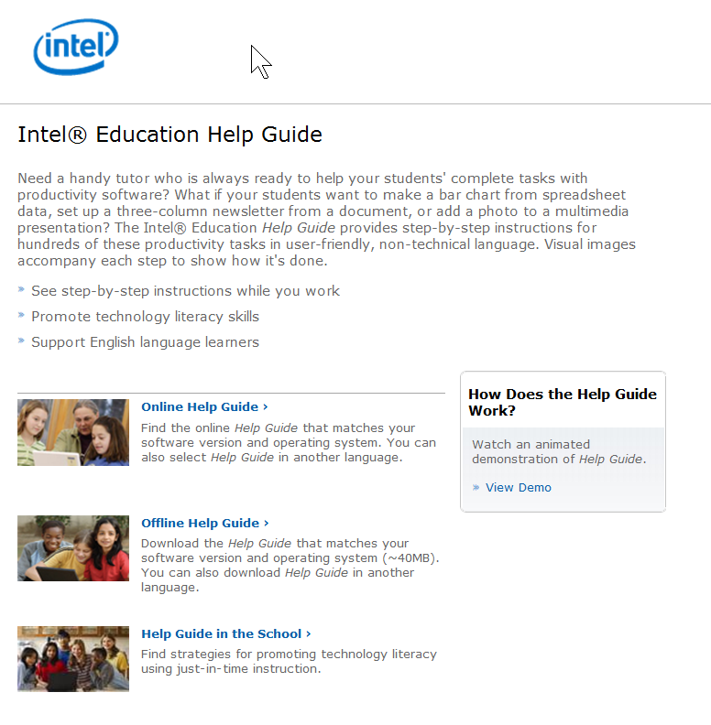
You can access the Intel Education Help Guide from the Intel web site. Using your web browser, type in: http://www.intel.com/education/helpguide
That will take you to a landing page that looks like this.
Note that there is a brief video that will demonstrate how to use the Help Guide
You can start the Help Guide by putting your cursor over the words Online Help Guide, then “left click”

Slide 33
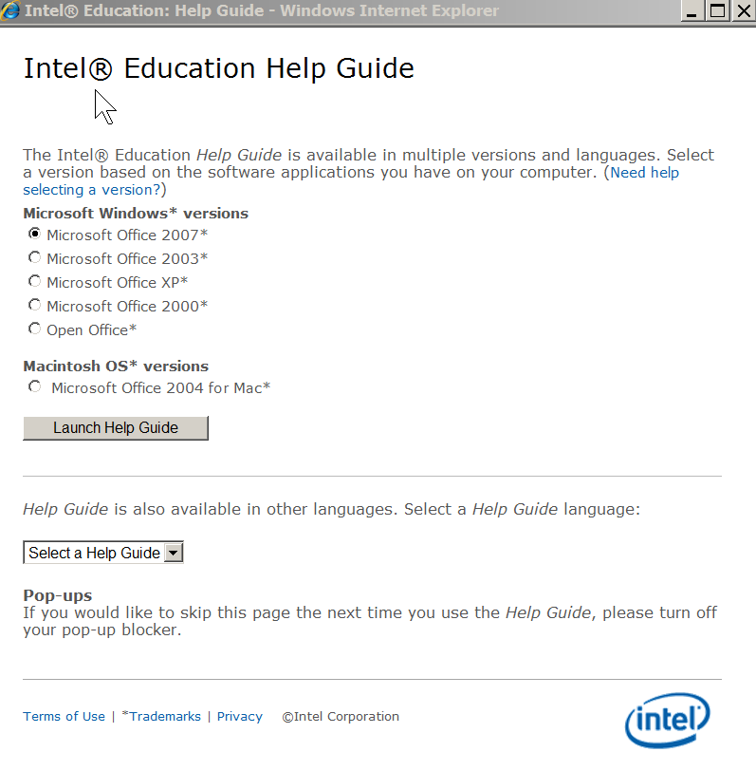
You will then see a screen that will prompt you to either launch the Help Guide,
Or,
Select an option available in another language

Slide 34
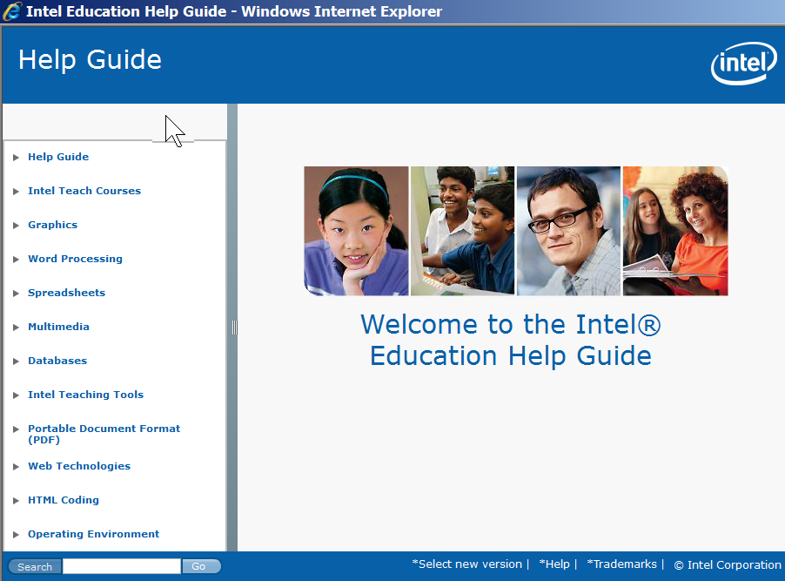
When the Help Guide opens, you’ll see a Welcome page that looks like this. Note that in the left channel, there are links to a variety of types of software instruction.
For this example, suppose you are looking for the Help Guide section on Graphics, Skill 9.1. Start by putting your cursor over the word Graphics, then “left click”

Slide 35
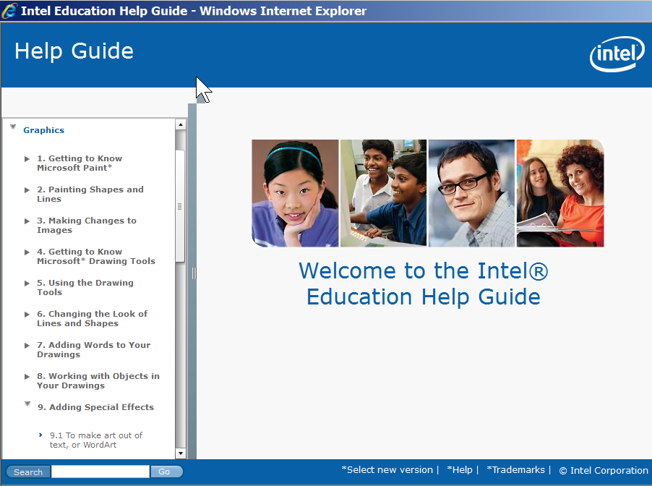
When you open the section on Graphics, scroll down until you find the skill you were looking for: Skill 9.1: To make art out of text or Word Art . Put your cursor over that section, and “left click”

Slide 36
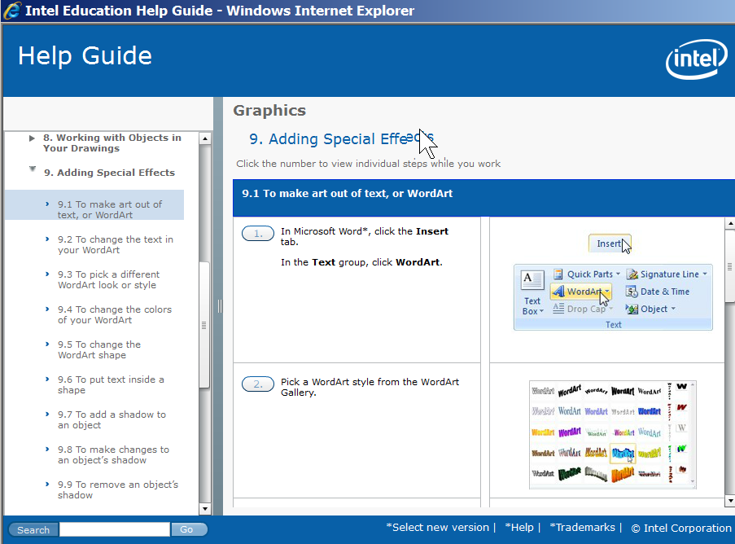
That will open the screen that gives you the step-by-step instructions you need to make art out of text or Word Art
You can view the steps in two ways. One way is to scroll through to see all the steps. Use the scroll bar on the right

Slide 37
The other way is to put your cursor on top of the number 1 on the first step, and “left click”.

Slide 38
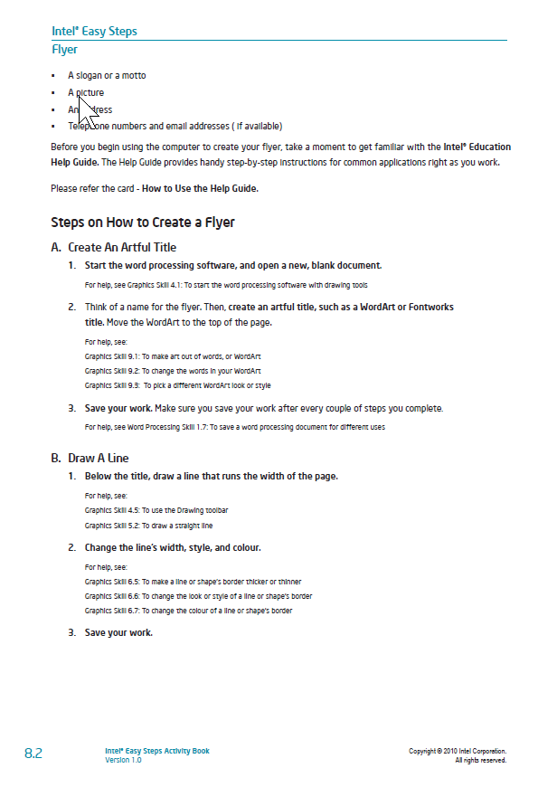
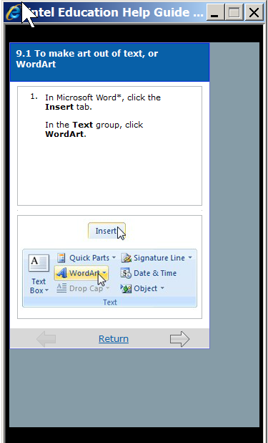
That will put the Help Guide step into a smaller window, which you can see on your screen at the same time as you work on your project. To advance to the next skill step, simply click on the arrow at the bottom of the window.

Slide 39
Contact
Peter Broffman
Corporate Affairs Group
Email: peter.broffman@intel.com
Phone: +1-503-613-3193

